Slide 1
Crash Course in Causal Inference
ECON 380

Slide 2
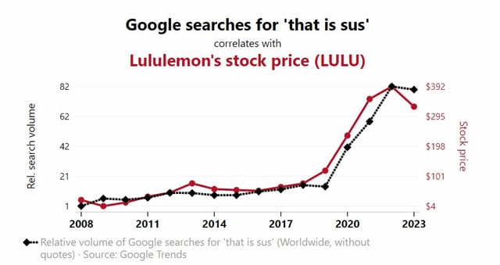
Quick Motivation

Slide 3
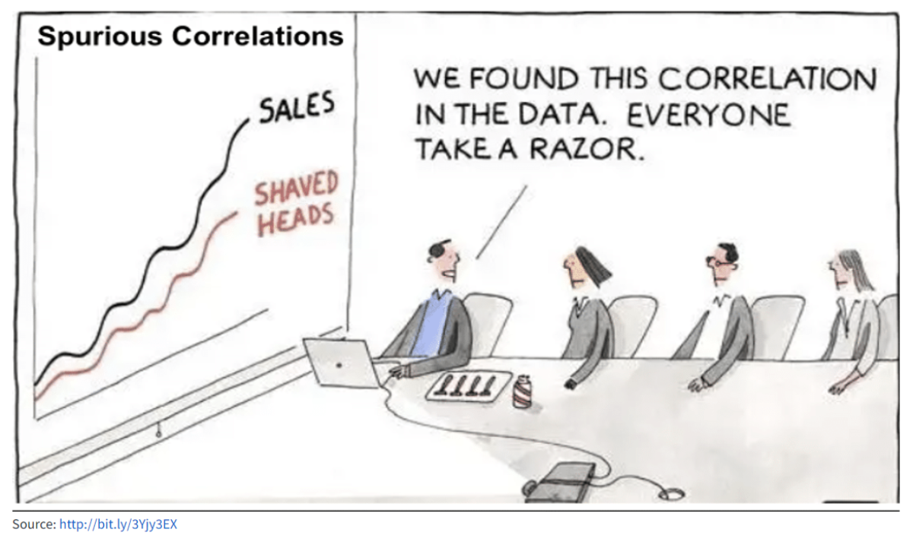
Quick Motivation

Slide 4
The Fundamental Problem of Causal Inference
Let’s suppose that we are trying to estimate the effect of job training program on participants’ future labor market performance.
We suspect that participating in a job training program will contribute to better outcomes in the job search process.
Suppose that we observe that “people who attended job training programs on average receive more job offers.”
Is this enough to conclude that the training program is effective?

Slide 5
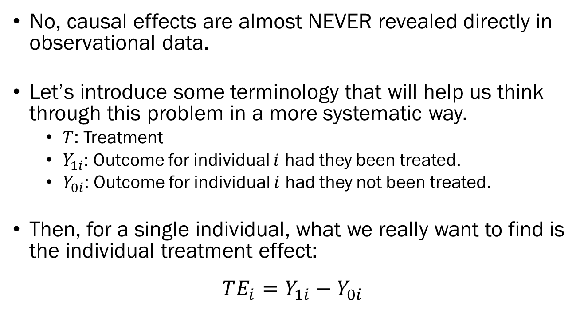
The Fundamental Problem of Causal Inference
No, causal effects are almost NEVER revealed directly in observational data.
Let’s introduce some terminology that will help us think through this problem in a more systematic way.
$T$: Treatment
$Y_{1i}$: Outcome for individual $i$ had they been treated.
$Y_{0i}$: Outcome for individual $i$ had they not been treated.
Then, for a single individual, what we really want to find is the individual treatment effect:
$$TE_{i}=Y_{1i}−Y_{0i}$$

Slide 6
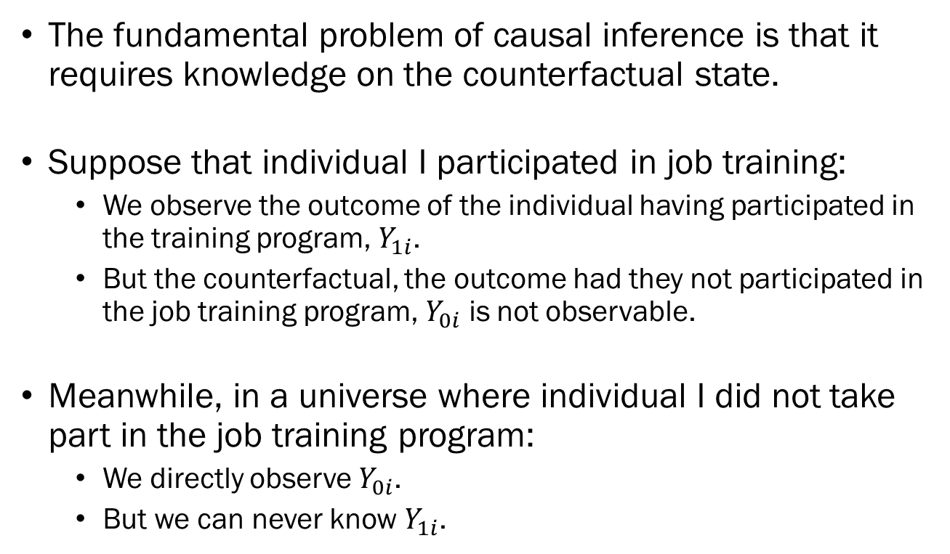
The Fundamental Problem of Causal Inference
The fundamental problem of causal inference is that it requires knowledge on the counterfactual state.
Suppose that individual I participated in job training:
We observe the outcome of the individual having participated in the training program, $Y_{1i}$.
But the counterfactual, the outcome had they not participated in the job training program, $Y_{0i}$ is not observable.
Meanwhile, in a universe where individual I did not take part in the job training program:
We directly observe $Y_{0i}$.
But we can never know $Y_{1i}$.

Slide 7
The Fundamental Problem of Causal Inference
This is a fundamental question, which does not have a solution, but there are some work-arounds.
Assume Stability and Reversibility:
Assume that we can expose an individual to a treatment, then “un-treat” the individual, and observe the effect of not treating.
Works in very limited conditions, and not applicable for humans.
Assume Homogeneity:
Assume that the treatment effect is identical for all individuals.
May work in a certain environments, but generally not applicable for humans.

Slide 8
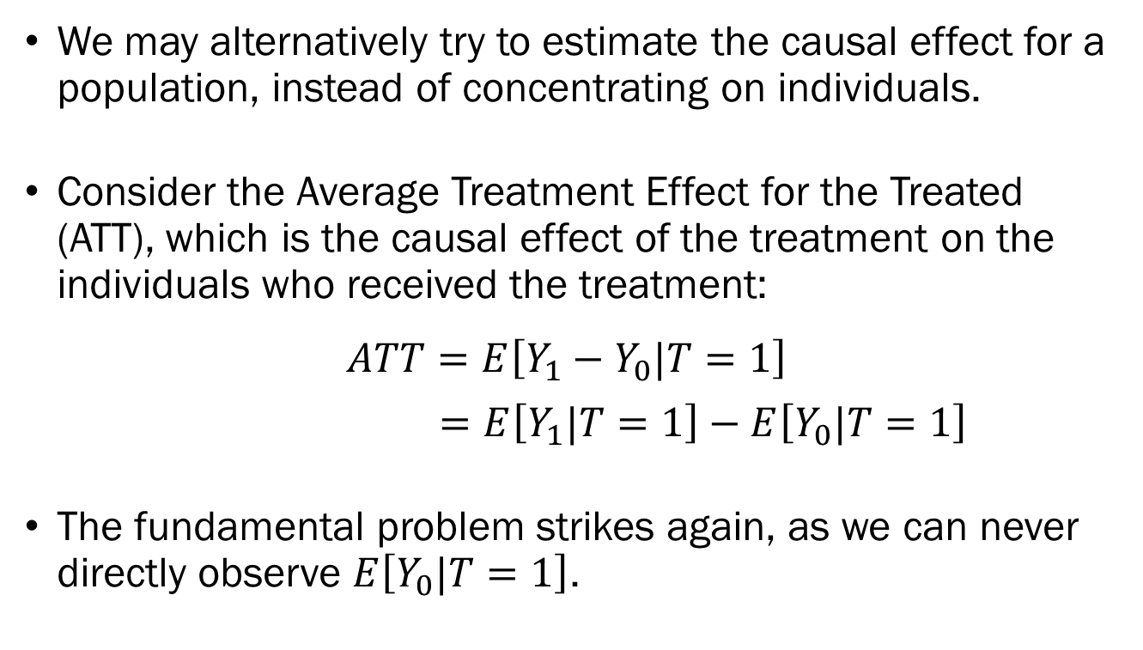
The Fundamental Problem of Causal Inference
We may alternatively try to estimate the causal effect for a population, instead of concentrating on individuals.
Consider the Average Treatment Effect for the Treated (ATT), which is the causal effect of the treatment on the individuals who received the treatment:
$$ATT=E\left[Y_{1}−Y_{0}|T=1\right]$$
$=E\left[Y_{1}|T=1\right]−E\left[Y_{0}|T=1\right]$
The fundamental problem strikes again, as we can never directly observe $E\left[Y_{0}|T=1\right]$.

Slide 9
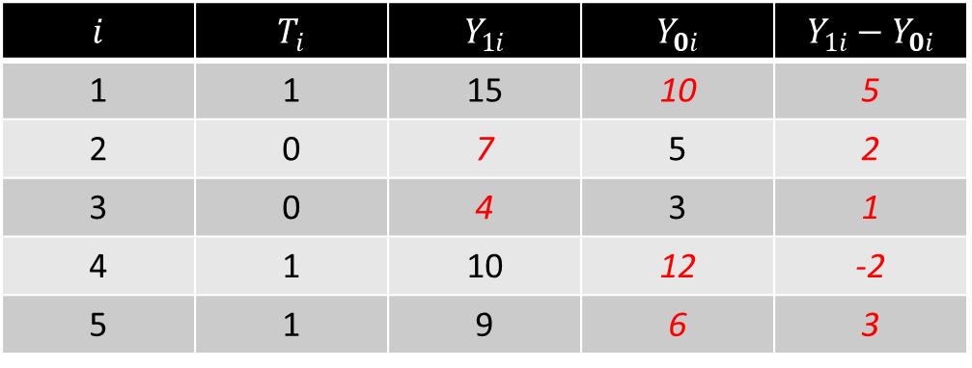
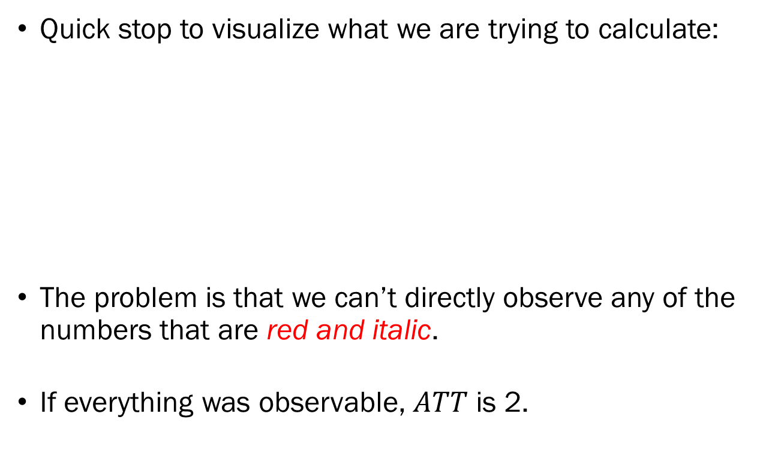
The Fundamental Problem of Causal Inference
Quick stop to visualize what we are trying to calculate:
The problem is that we can’t directly observe any of the numbers that are red and italic.
If everything was observable, $ATT$ is 2.
$$i$$ | $$T_{i}$$ | $$Y_{1i}$$ | $$Y_{0i}$$ | $$Y_{1i}−Y_{0i}$$
1 | 1 | 15 | 10 | 5
2 | 0 | 7 | 5 | 2
3 | 0 | 4 | 3 | 1
4 | 1 | 10 | 12 | -2
5 | 1 | 9 | 6 | 3

Slide 10
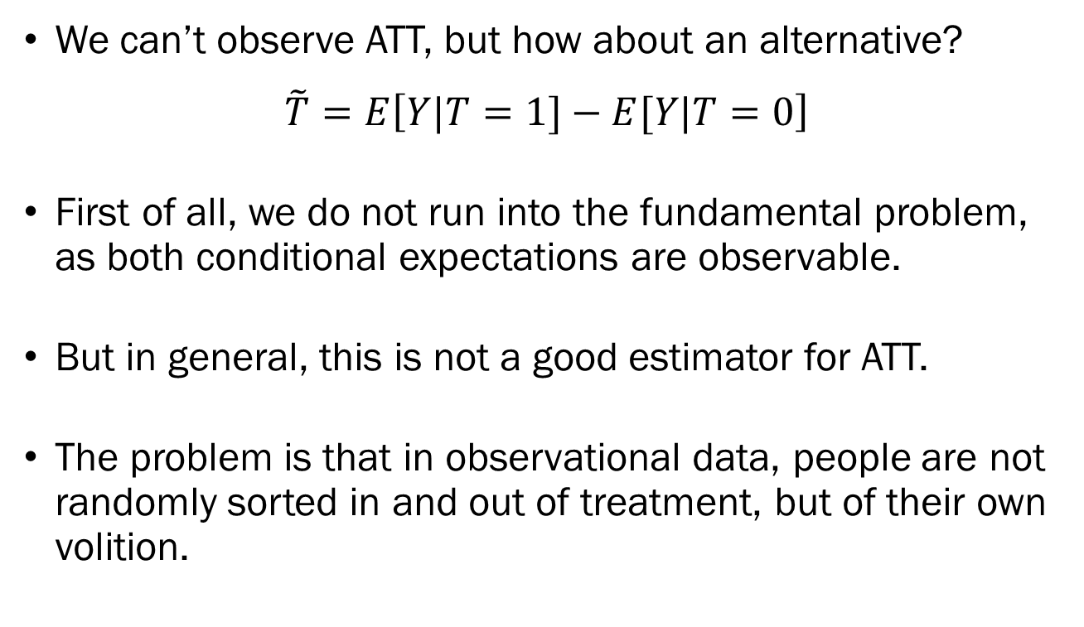
The Fundamental Problem of Causal Inference
We can’t observe ATT, but how about an alternative?
$$\tilde{T}=E\left[Y|T=1]−E[Y|T=0\right]$$
First of all, we do not run into the fundamental problem, as both conditional expectations are observable.
But in general, this is not a good estimator for ATT.
The problem is that in observational data, people are not randomly sorted in and out of treatment, but of their own volition.

Slide 11
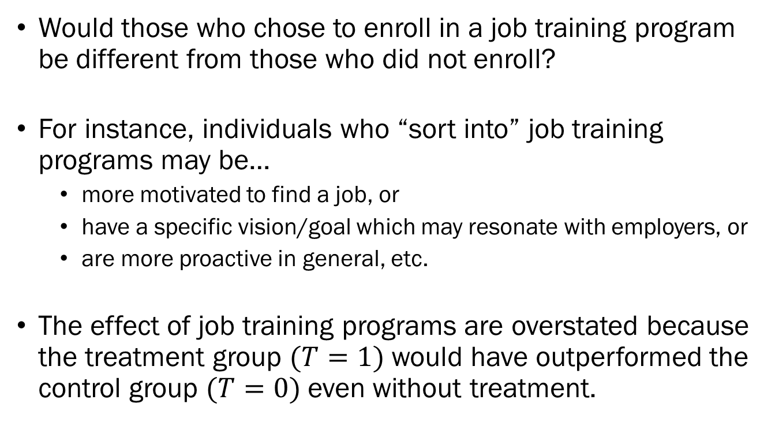
The Fundamental Problem of Causal Inference
Would those who chose to enroll in a job training program be different from those who did not enroll?
For instance, individuals who “sort into” job training programs may be…
more motivated to find a job, or
have a specific vision/goal which may resonate with employers, or
are more proactive in general, etc.
The effect of job training programs are overstated because the treatment group $(T=1)$ would have outperformed the control group $(T=0)$ even without treatment.

Slide 12
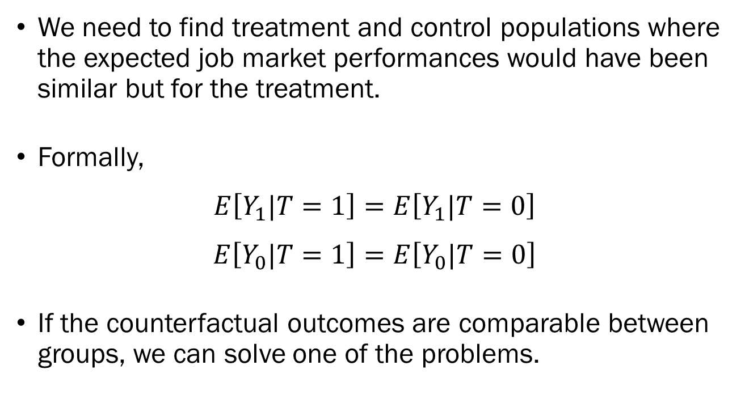
The Fundamental Problem of Causal Inference
We need to find treatment and control populations where the expected job market performances would have been similar but for the treatment.
Formally,
$$E\left[Y_{1}|T=1\right]=E\left[Y_{1}|T=0\right]$$
$$E\left[Y_{0}|T=1\right]=E\left[Y_{0}|T=0\right]$$
If the counterfactual outcomes are comparable between groups, we can solve one of the problems.

Slide 13
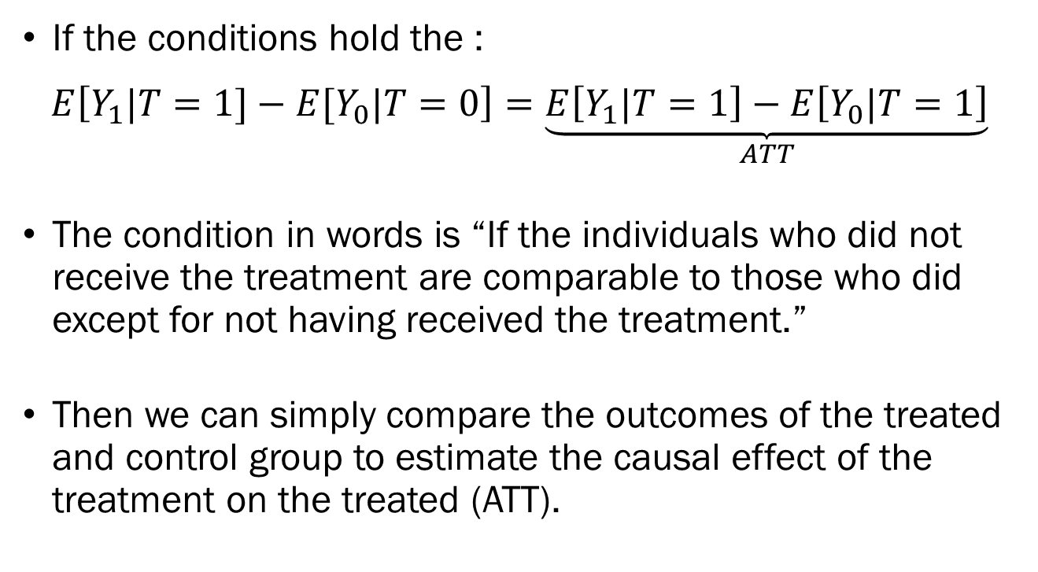
The Fundamental Problem of Causal Inference
If the conditions hold the :
$$E\left[Y_{1}|T=1]−E[Y_{0}|T=0\right]=\underset{ATT}{\underbrace{E\left[Y_{1}|T=1\right]−E\left[Y_{0}|T=1\right]}}$$
The condition in words is “If the individuals who did not receive the treatment are comparable to those who did except for not having received the treatment.”
Then we can simply compare the outcomes of the treated and control group to estimate the causal effect of the treatment on the treated (ATT).

Slide 14
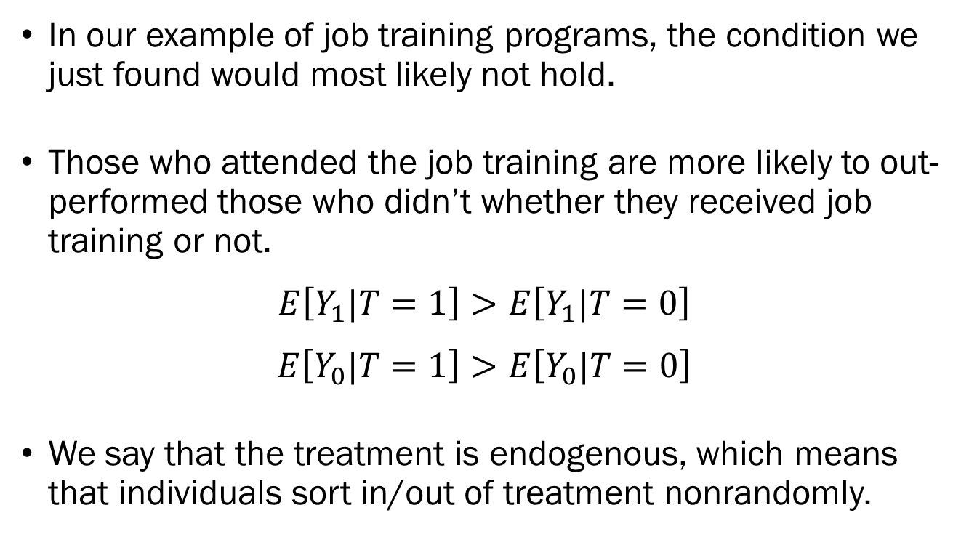
The Fundamental Problem of Causal Inference
In our example of job training programs, the condition we just found would most likely not hold.
Those who attended the job training are more likely to out-performed those who didn’t whether they received job training or not.
$$E\left[Y_{1}|T=1\right]>E\left[Y_{1}|T=0\right]$$
$$E\left[Y_{0}|T=1\right]>E\left[Y_{0}|T=0\right]$$
We say that the treatment is endogenous, which means that individuals sort in/out of treatment nonrandomly.

Slide 15
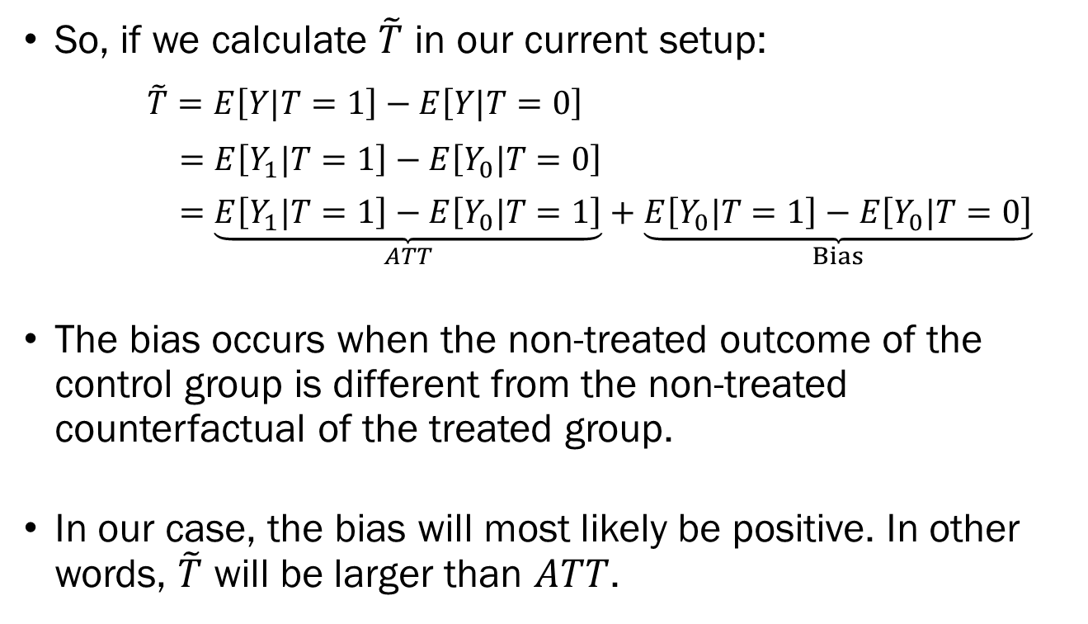
The Fundamental Problem of Causal Inference
So, if we calculate $\tilde{T}$ in our current setup:
$\tilde{T}=E\left[Y|T=1\right]−E\left[Y|T=0\right]$
$=E\left[Y_{1}|T=1\right]−E\left[Y_{0}|T=0\right]$
$=\underset{ATT}{\underbrace{E\left[Y_{1}|T=1\right]−E\left[Y_{0}|T=1\right]}}+\underset{Bias}{\underbrace{E\left[Y_{0}|T=1\right]−E\left[Y_{0}|T=0\right]}}$
The bias occurs when the non-treated outcome of the control group is different from the non-treated counterfactual of the treated group.
In our case, the bias will most likely be positive. In other words, $\tilde{T}$ will be larger than $ATT$.

Slide 16
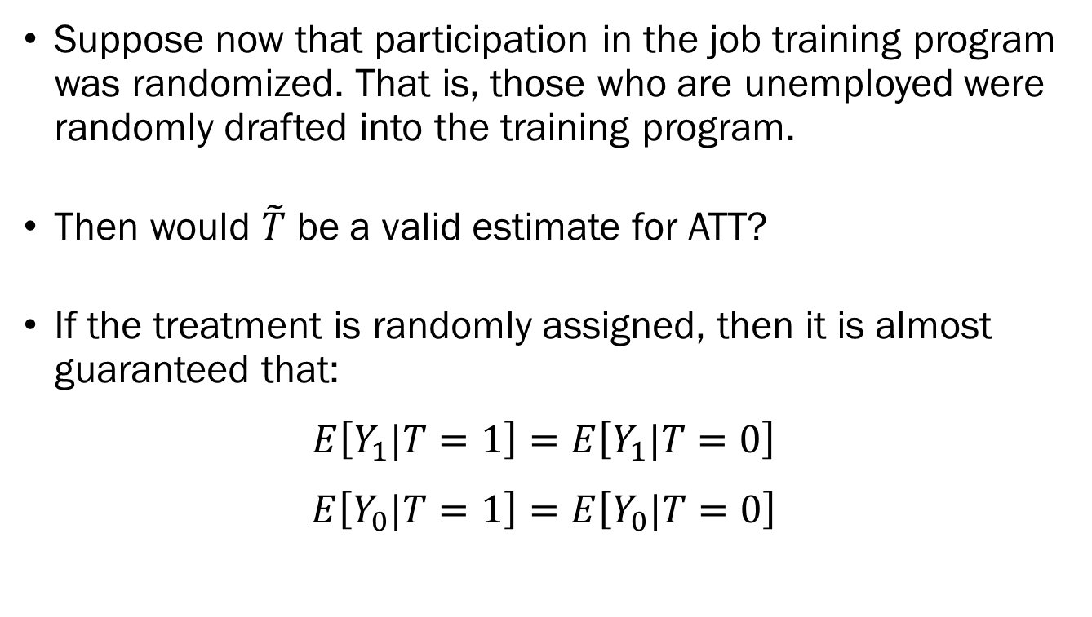
Randomization as a Workaround
Suppose now that participation in the job training program was randomized. That is, those who are unemployed were randomly drafted into the training program.
Then would $\tilde{T}$ be a valid estimate for ATT?
If the treatment is randomly assigned, then it is almost guaranteed that:
$$E\left[Y_{1}|T=1\right]=E\left[Y_{1}|T=0\right]$$
$$E\left[Y_{0}|T=1\right]=E\left[Y_{0}|T=0\right]$$

Slide 17
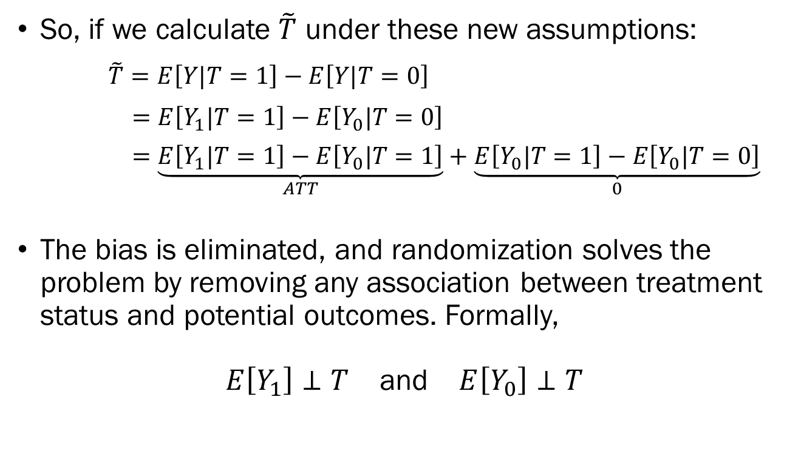
Randomization as a Workaround
So, if we calculate $\tilde{T}$ under these new assumptions:
$\tilde{T}=E\left[Y|T=1\right]−E\left[Y|T=0\right]$
$=E\left[Y_{1}|T=1\right]−E\left[Y_{0}|T=0\right]$
$=\underset{ATT}{\underbrace{E\left[Y_{1}|T=1\right]−E\left[Y_{0}|T=1\right]}}+\underset{0}{\underbrace{E\left[Y_{0}|T=1\right]−E\left[Y_{0}|T=0\right]}}$
The bias is eliminated, and randomization solves the problem by removing any association between treatment status and potential outcomes. Formally,
$E\left[Y_{1}\right]⊥T$ and $E\left[Y_{0}\right]⊥T$

Slide 18
Randomization as a Workaround?
Randomization is an incredibly powerful workaround, but it is rarely viable when it comes to studies on human subjects.
Suppose you want to find the causal effect of smoking on the likelihood of developing cancer.
Can you possibly justify randomly forcing individuals to smoke against their will?
So, in practical research environments, we rely on other statistical methods.

Slide 19
Overview of “Methods”
Throughout the next few lectures, we will be surveying a few statistical methods commonly used in causal inference using observational data.
The list of topics include the following techniques:
Natural Experiments
Instrumental Variables
Difference-in-Differences
Regression Discontinuity
Synthetic Control Methods
Propensity Score Matching

Slide 20
Natural Experiments
Natural experiments works just like randomization, but where the researcher is not in charge of randomizing.
When there is a clearly defined exposure, involving a well-defined group of people, such that changes in outcomes can be plausibly attributed to the random exposure.
Hurricanes, earthquakes, wildfires, droughts, floods, etc.
One iconic study leveraging natural experiments in the field of Environmental Economics is Hornbeck’s paper on the impact of the Dust Bowl of the 1930s.

Slide 21

The Dust Bowl

Slide 22
Hornbeck (2012) The American Economic Review
The dust bowl was not intentionally designed to affect certain areas of the U.S. over other regions.
The level of exposure to the dust bowl’s effects, key of which is the loss of soil, was determined by land characteristics and wind patterns.
Therefore, the “treatment” of soil erosion, in this study is plausibly exogenous.
The paper then shows decreases in population, land value, and revenue loss from high-erosion counties.

Slide 23
Natural Experiments
Things to consider when leveraging natural experiments:
The “natural experiment” must be truly exogenous, in the sense that an event or policy is not influenced by omitted confounders.
Also, the shock must be unexpected so that individuals cannot alter their behavior in anticipation of said natural experiment.
The treatment and control groups must be clearly identified.
While there are other technical issues and considerations, those are beyond the scope of this course.

Slide 24
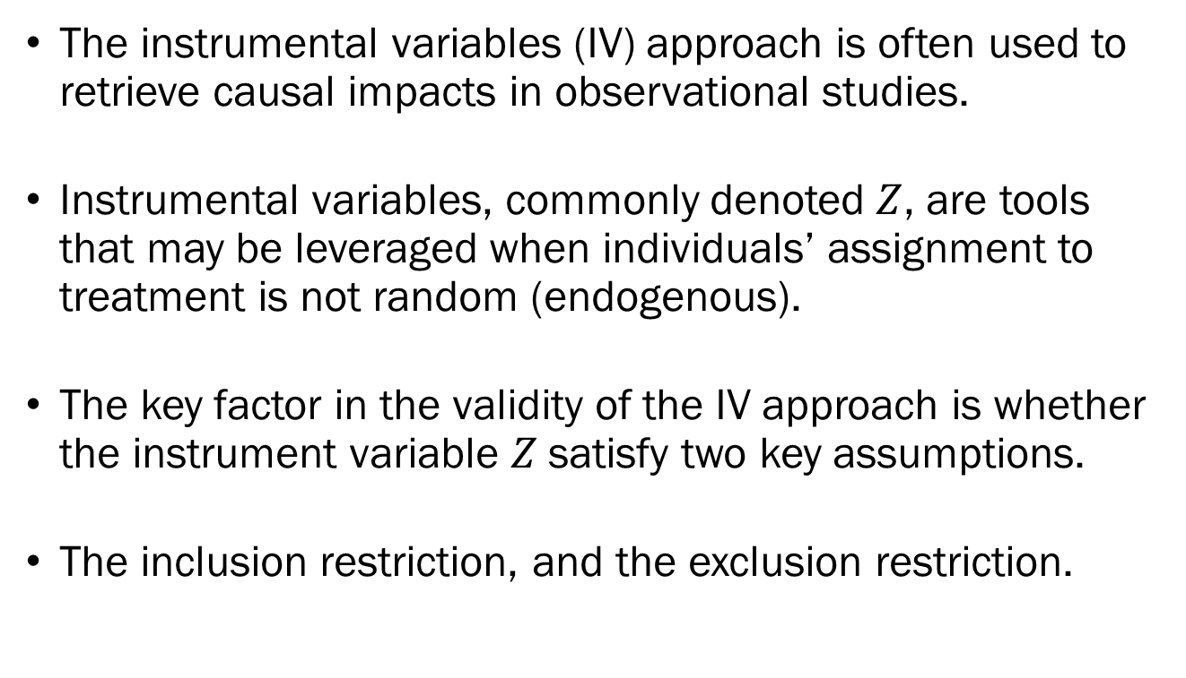
Instrumental Variables
The instrumental variables (IV) approach is often used to retrieve causal impacts in observational studies.
Instrumental variables, commonly denoted $Z$, are tools that may be leveraged when individuals’ assignment to treatment is not random (endogenous).
The key factor in the validity of the IV approach is whether the instrument variable $Z$satisfy two key assumptions.
The inclusion restriction, and the exclusion restriction.

Slide 25
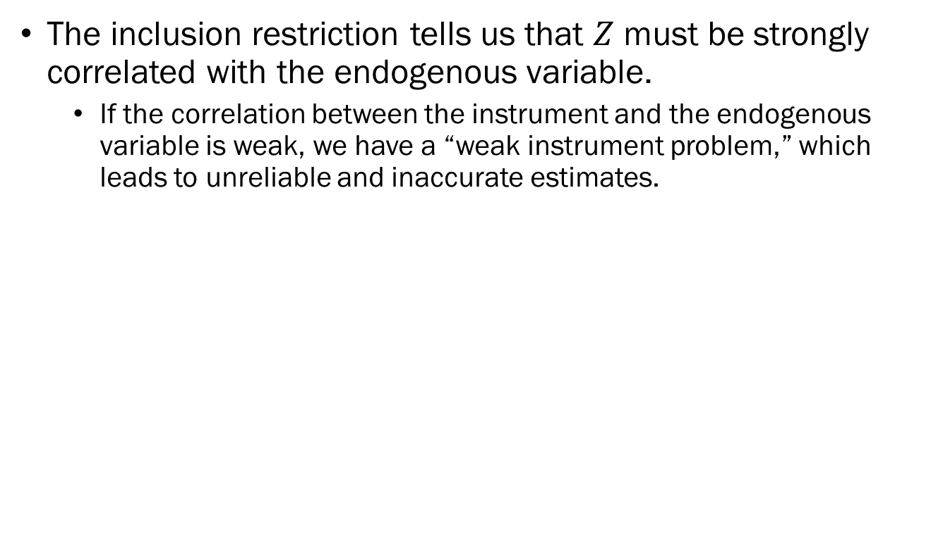
Instrumental Variables
The inclusion restriction tells us that $Z$ must be strongly correlated with the endogenous variable.
If the correlation between the instrument and the endogenous variable is weak, we have a “weak instrument problem,” which leads to unreliable and inaccurate estimates.
Z
X
Y

Slide 26
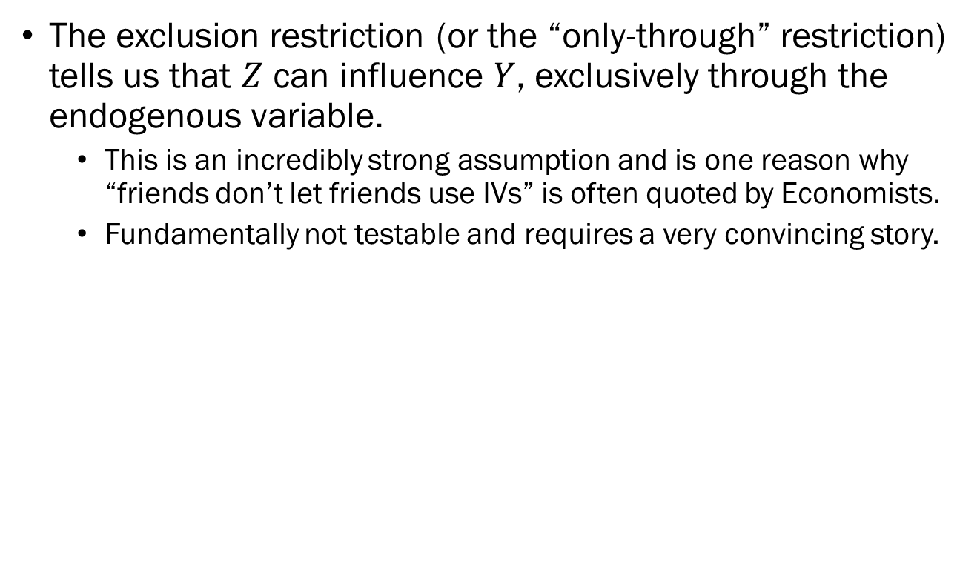
Instrumental Variables
The exclusion restriction (or the “only-through” restriction) tells us that $Z$ can influence $Y$, exclusively through the endogenous variable.
This is an incredibly strong assumption and is one reason why “friends don’t let friends use IVs” is often quoted by Economists.
Fundamentally not testable and requires a very convincing story.
Z
X
Y

Slide 27

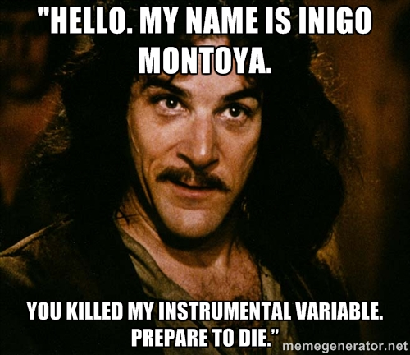
Instrumental Variables

Slide 28
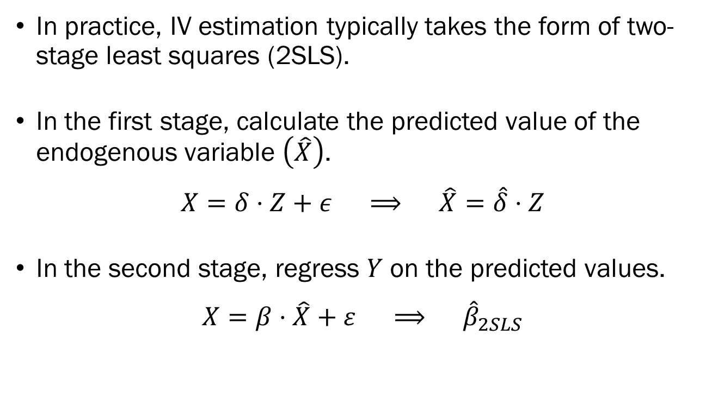
Instrumental Variables
In practice, IV estimation typically takes the form of two-stage least squares (2SLS).
In the first stage, calculate the predicted value of the endogenous variable $\left(\hat{X}\right)$.
$$X=δ⋅Z+ε ⟹ \hat{X}=\hat{δ}⋅Z$$
In the second stage, regress $Y$ on the predicted values.
$$X=β⋅\hat{X}+ε ⟹ {\hat{β}}_{2SLS}$$

Slide 29
Schlenker & Walker (2016) The Review of Economic Studies
One paper that leverage IVs in the field of Environmental Economics is Schlenker & Walker (2016), which estimates the impact of air pollution on health outcomes.
The problem is that pollution is rarely completely random and will be endogenous to local economic activity.
So simple measurements of air pollution at a location will suffer from endogeneity, which will bias the estimators.
The authors of this paper leverage knowledge of the airline industry to construct a convincing instrumental variable.

Slide 30

Schlenker & Walker (2016) The Review of Economic Studies

Slide 31
Schlenker & Walker (2016) The Review of Economic Studies
The authors noted that delays originating from east cost cities will lead to delays in airports based in California.
This leads to increased taxi time for commercial airplanes.
Once detached from the boarding bridge, commercial airliners must run their engines to generate electricity.
This leads to increased airborne pollutants in California, which had nothing to do with local conditions in California.
Does this instrument satisfy the exclusion restriction?

Slide 32
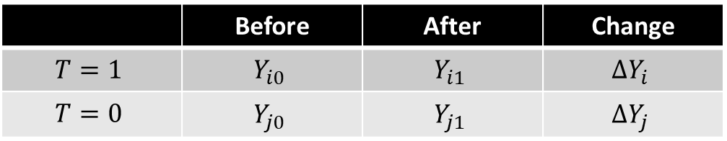
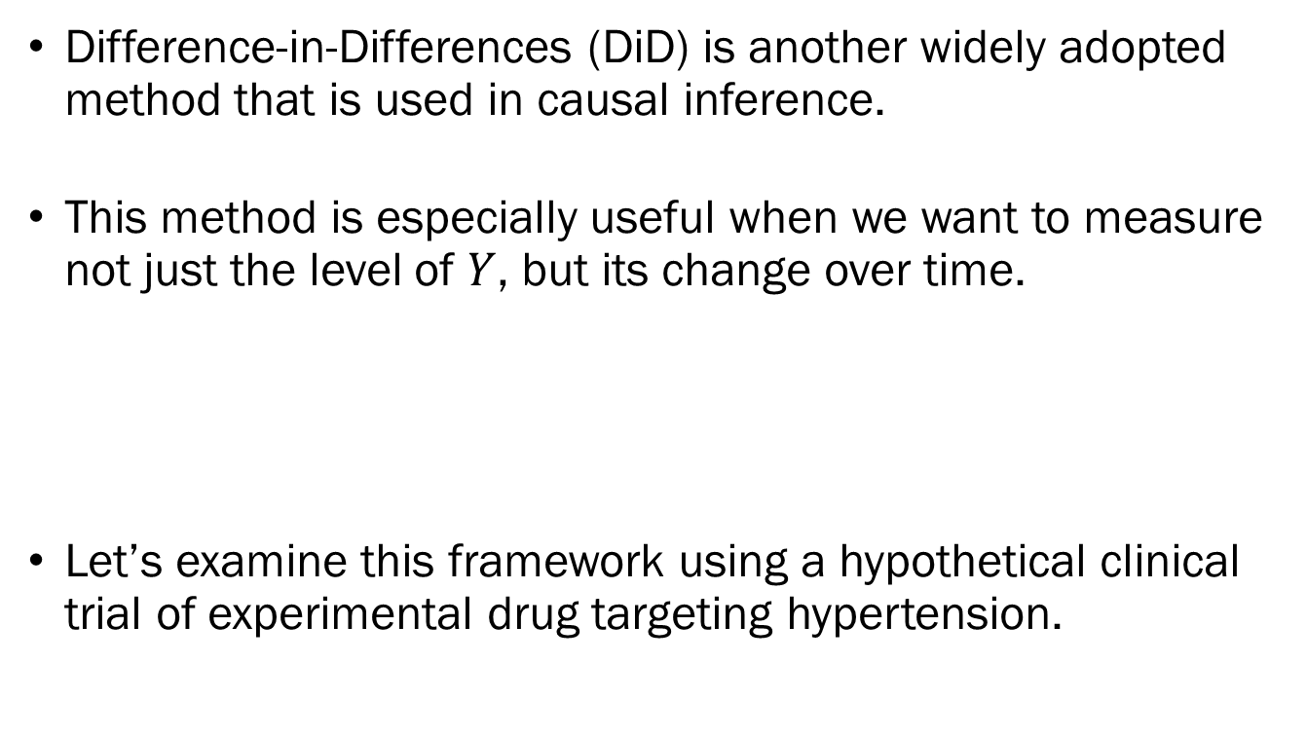
Difference-in-Differences
Difference-in-Differences (DiD) is another widely adopted method that is used in causal inference.
This method is especially useful when we want to measure not just the level of $Y$, but its change over time.
Let’s examine this framework using a hypothetical clinical trial of experimental drug targeting hypertension.
 | Before | After | Change
$$T=1$$ | $$Y_{i0}$$ | $$Y_{i1}$$ | $$ΔY_{i}$$
$$T=0$$ | $$Y_{j0}$$ | $$Y_{j1}$$ | $$ΔY_{j}$$

Slide 33
Difference-in-Differences
Suppose we have a group of 100 people, and we randomly sort half into the treatment group given the experimental drug, and the remainder given a placebo.
A concern may arise, due to the relatively small sample, that the two groups are not nicely balanced in terms of baseline blood pressure levels.
Compare the baseline average between groups.
Ideally, we would want the average levels to be identical, or at least similar.

Slide 34
Difference-in-Differences
What if it turns out that the treatment group’s blood pressure was slightly lower than the control group?
By simply comparing the outcomes following treatment, we would be concerned that the estimates would be biased.
This is why we might want to compare the “change” in the blood pressure in the treatment group to the “change” in the blood pressure in the control group.
By examining the change in the outcome variable, we will cancel out initial differences that may confound results.

Slide 35
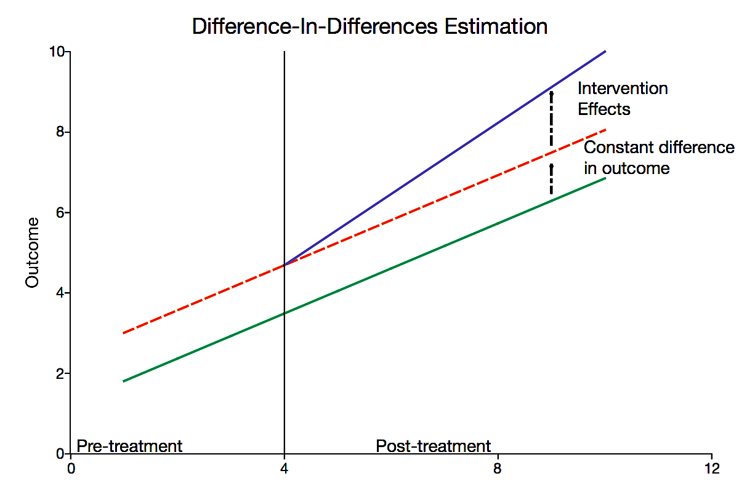
Difference-in-Differences

Slide 36
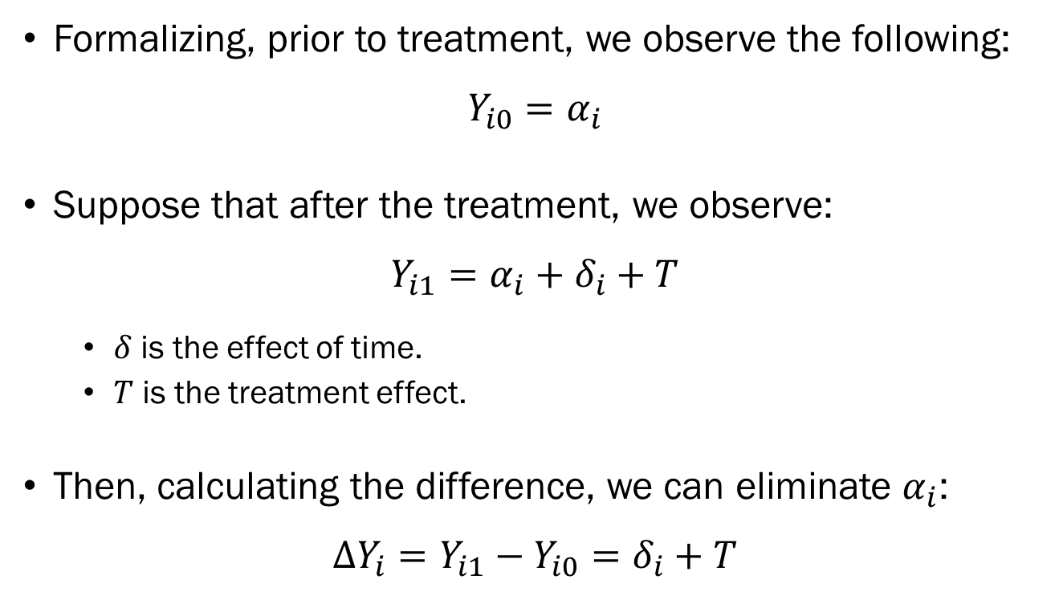
Difference-in-Differences
Formalizing, prior to treatment, we observe the following:
$$Y_{i0}=α_{i}$$
Suppose that after the treatment, we observe:
$$Y_{i1}=α_{i}+δ_{i}+T$$
$δ$ is the effect of time.
$T$ is the treatment effect.
Then, calculating the difference, we can eliminate $α_{i}$:
$$ΔY_{i}=Y_{i1}−Y_{i0}=δ_{i}+T$$

Slide 37
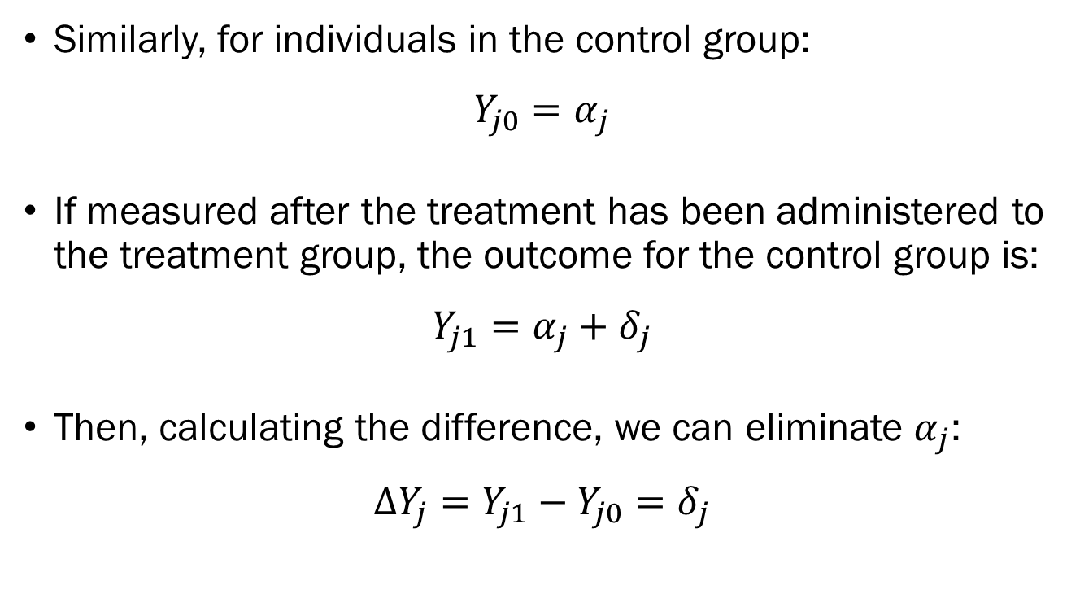
Difference-in-Differences
Similarly, for individuals in the control group:
$$Y_{j0}=α_{j}$$
If measured after the treatment has been administered to the treatment group, the outcome for the control group is:
$$Y_{j1}=α_{j}+δ_{j}$$
Then, calculating the difference, we can eliminate $α_{j}$:
$$ΔY_{j}=Y_{j1}−Y_{j0}=δ_{j}$$

Slide 38
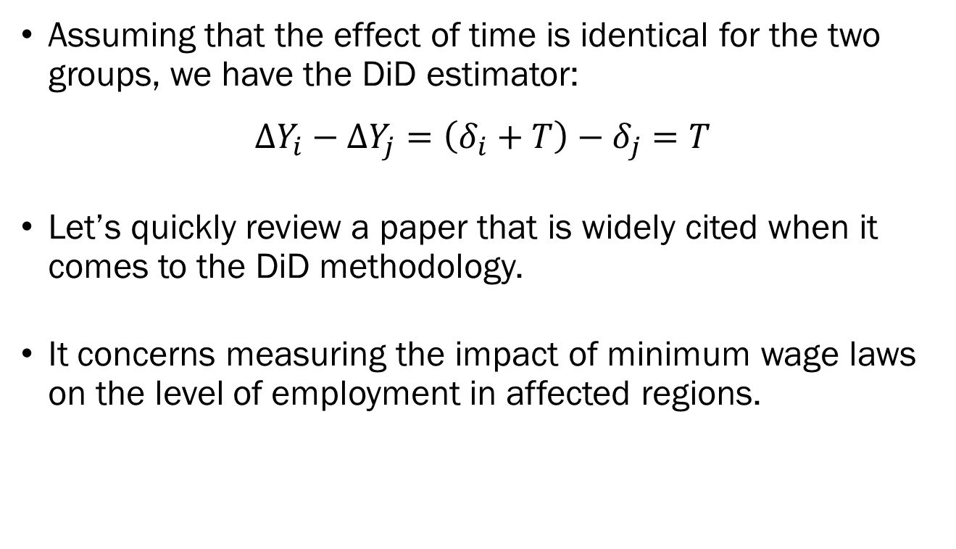
Difference-in-Differences
Assuming that the effect of time is identical for the two groups, we have the DiD estimator:
$$ΔY_{i}−ΔY_{j}=\left(δ_{i}+T\right)−δ_{j}=T$$
Let’s quickly review a paper that is widely cited when it comes to the DiD methodology.
It concerns measuring the impact of minimum wage laws on the level of employment in affected regions.

Slide 39
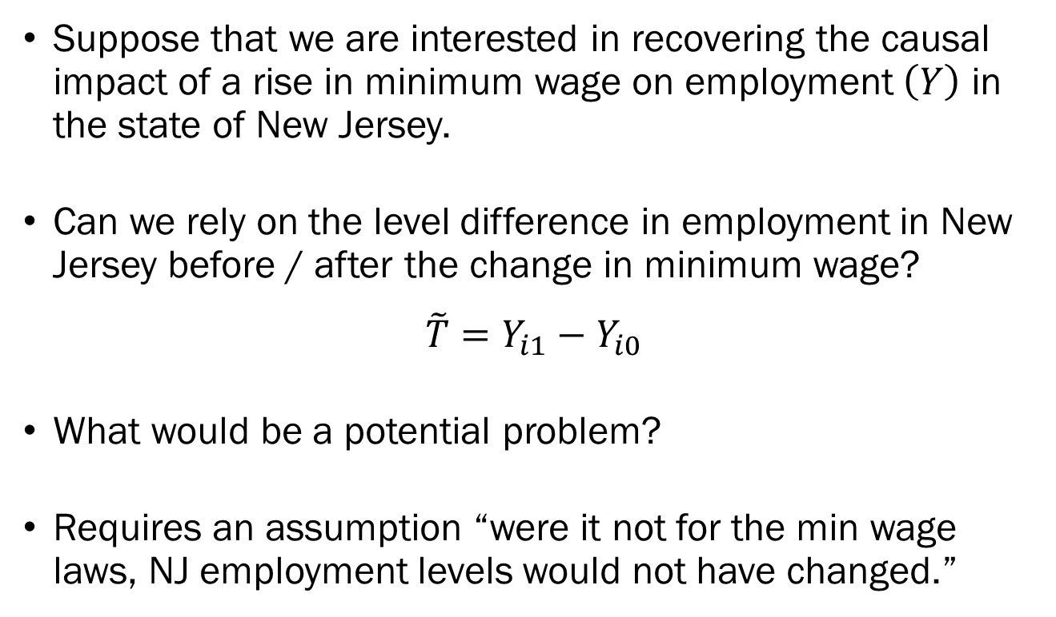
Difference-in-Differences
Suppose that we are interested in recovering the causal impact of a rise in minimum wage on employment $\left(Y\right)$ in the state of New Jersey.
Can we rely on the level difference in employment in New Jersey before / after the change in minimum wage?
$$\tilde{T}=Y_{i1}−Y_{i0}$$
What would be a potential problem?
Requires an assumption “were it not for the min wage laws, NJ employment levels would not have changed.”

Slide 40
Difference-in-Differences
Not a plausible assumption at all.
The ideal experiment would have the researcher randomly expose some states to sudden shifts in minimum wages.
Also, not even close to plausible.
One way to deal with this situation is to find a comparable state to NJ that did not experience the change in minimum wage laws.
In early 1992, it was Pennsylvania.

Slide 41
Card & Krueger (1994) The American Economic Review
In April of 1992, the minimum wage in NJ and PA:
NJ: Increased from $4.25 to $5.05, an 18.8% increase.
PA: Stayed constant at the Federal minimum wage, $4.25.
The pre/post treatment period is defined as:
Pre: Feb ~ Mar of 1992
Post: Nov ~ Dec of 1992
Authors surveyed 400+ fast food restaurants across NJ and eastern PA.
Treatment: Fast food restaurants in NJ
Control: Fast food restaurants in eastern PA

Slide 42
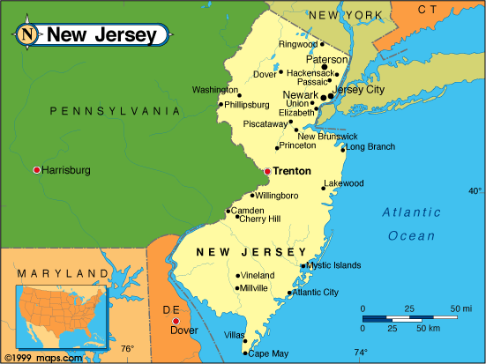
Card & Krueger (1994) The American Economic Review

Slide 43
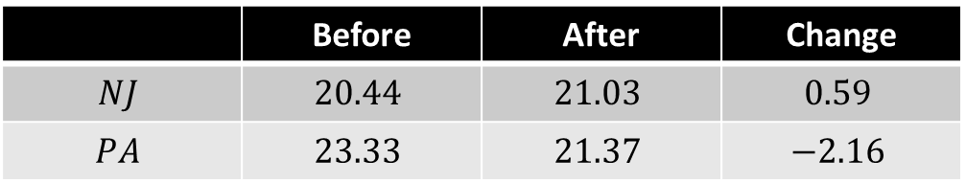
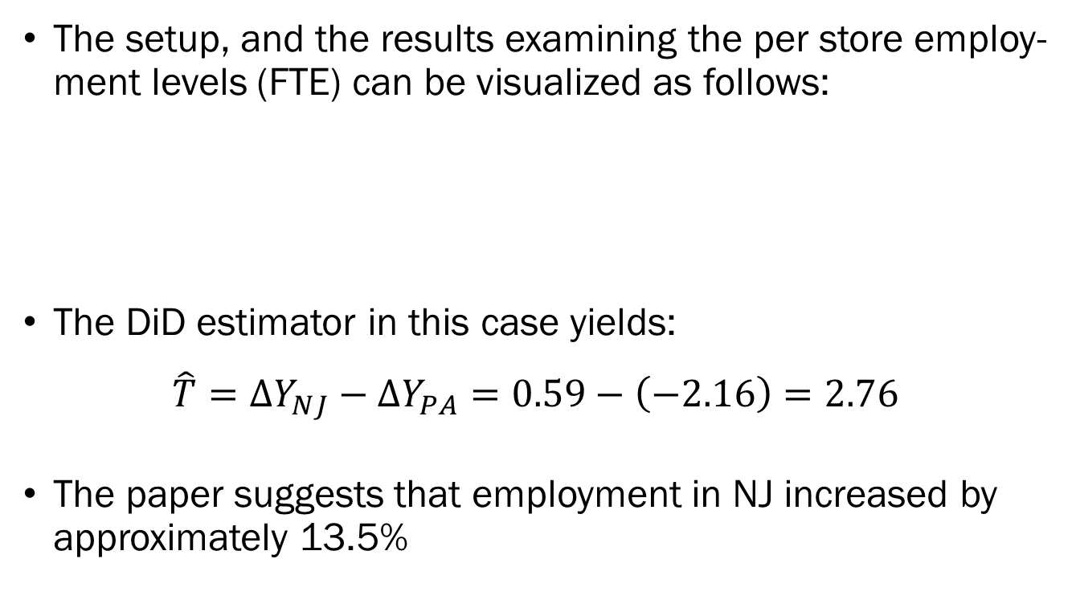
Card & Krueger (1994) The American Economic Review
The setup, and the results examining the per store employ-ment levels (FTE) can be visualized as follows:
The DiD estimator in this case yields:
$$\hat{T}=ΔY_{NJ}−ΔY_{PA}=0.59−\left(−2.16\right)=2.76$$
The paper suggests that employment in NJ increased by approximately 13.5%
 | Before | After | Change
$$NJ$$ | $$20.44$$ | $$21.03$$ | $$0.59$$
$$PA$$ | $$23.33$$ | $$21.37$$ | $$−2.16$$

Slide 44
Difference-in-Differences
Things to consider before applying DiD:
Pre-treatment outcome variable for treatment and control groups must follow a parallel trend.
Treatment status cannot depend on factors that may also affect the outcome variable.
No spillovers of the treatment into the control group.
No anticipation effects.
While there are other technical issues and considerations, those are beyond the scope of this course.

Slide 45
Regression Discontinuity
Regression Discontinuity (RD) is another widely adopted quasi-experimental method used in causal inference.
RD is a quasi-experimental design used to estimate causal effects when treatment is assigned based on a cutoff in a continuous running variable.
While sorting in and out of treatment itself remains non-random, if we concentrate on those very close to the threshold, the treatment assignment is as good as random.

Slide 46
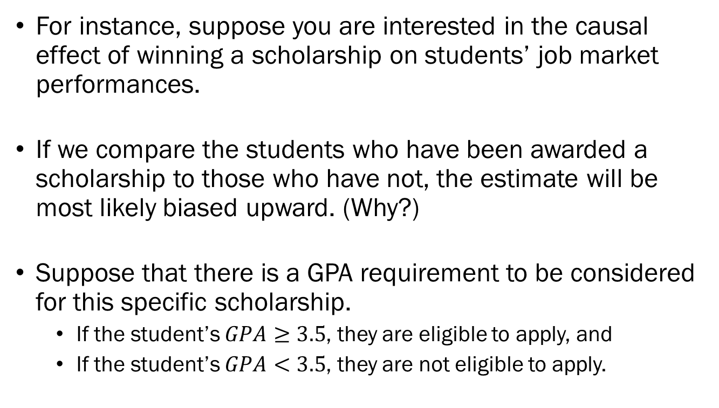
Regression Discontinuity
For instance, suppose you are interested in the causal effect of winning a scholarship on students’ job market performances.
If we compare the students who have been awarded a scholarship to those who have not, the estimate will be most likely biased upward. (Why?)
Suppose that there is a GPA requirement to be considered for this specific scholarship.
If the student’s $GPA≥3.5$, they are eligible to apply, and
If the student’s $GPA<3.5$, they are not eligible to apply.

Slide 47
Regression Discontinuity
If we exclusively look at students whose GPA is very close to the cutoff of 3.5, the assignment to treatment may be plausibly exogenous.
Of course, there are some conditions that must be met, where the following two are the most important:
Individuals near the cutoff must be similar in the absence of treatment.
Individuals must not be able to manipulate the running variable.
Further technical discussions, we will ignore for now.
Sharp vs Fuzzy RD, Optimal Bandwidth, etc.

Slide 48
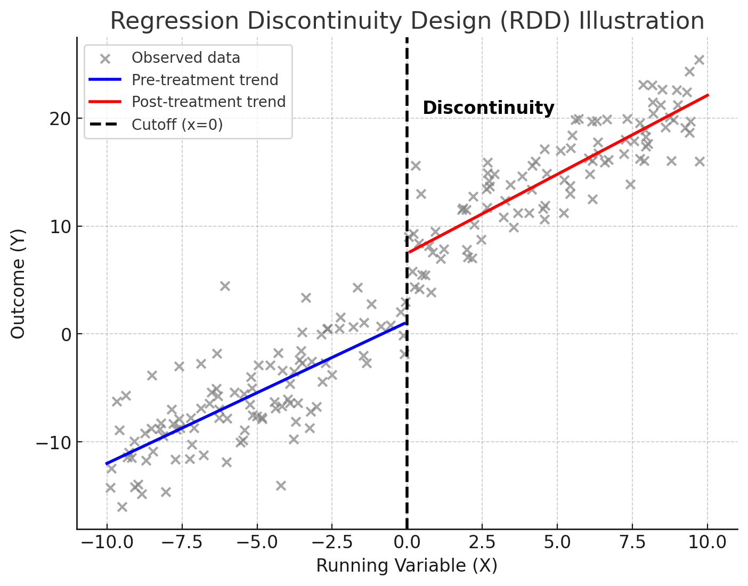
Regression Discontinuity

Slide 49
Almond, Chen, Greenstone, Li (2009) American Economic Review: Papers & Proceedings
The running variable could also be defined in terms of geography, as demonstrated in the paper on the effect of air pollution on health outcomes.
The Huai River Policy was a heating policy implemented by the Chinese government during the central planning period.
It was designed to provide free winter heating to urban areas north of the Huai River, but not to the south, due to budget constraints.

Slide 50
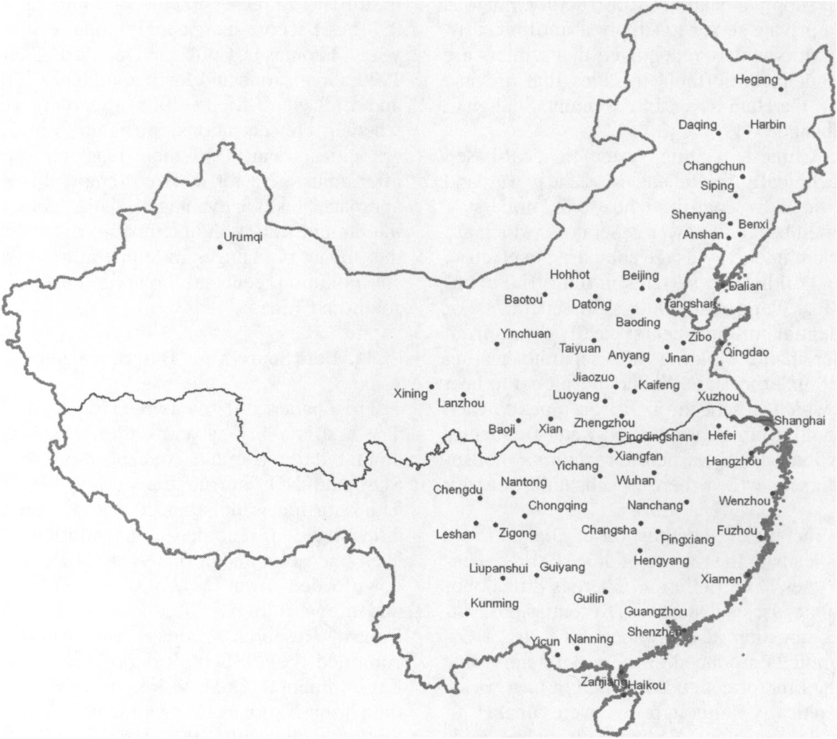
Almond, Chen, Greenstone, Li (2009) American Economic Review: Papers & Proceedings
Established a heating cutoff at the Huai River, which separated northern and southern China.
Cities north of the Huai River received free heating from November to March.
Cities south of the Huai River did not receive government-provided heating.

Slide 51
Almond, Chen, Greenstone, Li (2009) American Economic Review: Papers & Proceedings
The heating system was coal-based and inefficient.
The policy resulted in significantly higher air pollution levels in northern China.

Slide 52
Regression Discontinuity
Things to consider before applying RD:
Individuals must not be able to manipulate the running variable.
The cutoff of the running variable must be exogenous.
There must be sufficient observations near the cutoff.
No other change can occur near the cutoff.
The estimate is “local” in nature, which means that the results are not necessarily generalizable.
While there are other technical issues and considerations, those are beyond the scope of this course.

Slide 53
Synthetic Control Methods
Sometimes, policies are implemented at an aggregate level, so that identifying a suitable control group is infeasible.
Synthetic Control Methods (SCM) can be used in such settings, in which we construct a control group using weighted combination of untreated units.
Suppose that Illinois adopted a state-wide policy.
While it is infeasible to select a single comparison state to use as the counterfactual, we can create a synthetic IL out of data from a group of other states.

Slide 54
Synthetic Control Methods
SCM is useful when there is only one treated unit, making it ideal for policy evaluations.
The terminology used in SCM is as follows:
Treated: The actual unit that received the intervention.
Synthetic Control: A weighted sum of similar untreated units.
Causal Effect: The difference between the actual treated unit’s post-intervention outcome and the synthetic control’s predicted outcome.
The specific internal workings of SCM is beyond the scope of this course.

Slide 55

Basque Country and ETA

Slide 56
Abadie & Gardeazabal (2003) The American Economic Review
The Basque Country, once one of Spain's richest regions, experienced decades of terrorist conflict due to ETA.
This paper estimates the causal effect of terrorism on the Basque economy by comparing its GDP with a synthetic control group.
Traditional methods require multiple treated and control units, but only one region was affected by terrorism.
About 10% lower GDP in the Basque Country compared to the synthetic control over two decades.

Slide 57
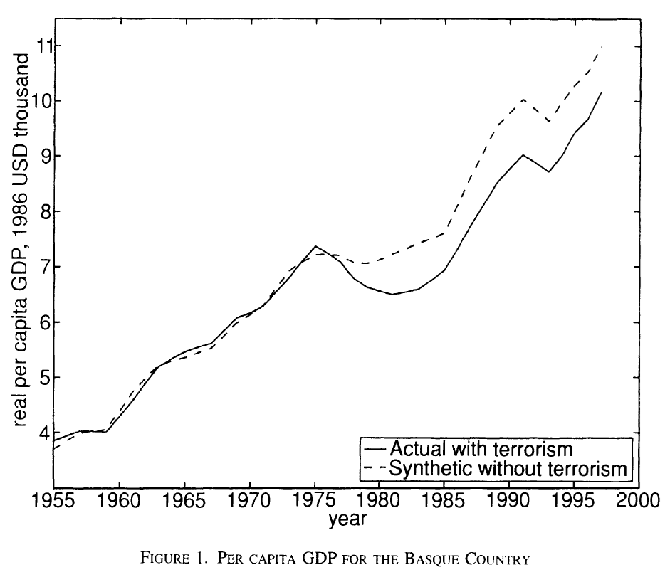
Abadie & Gardeazabal (2003) The American Economic Review
The solid line represents the actual GDP of Basque Country.
The dotted line illustrates the synthetic control’s GDP.
The sharp divergence after 1975 shows the negative impact of terrorism on economic activity.

Slide 58
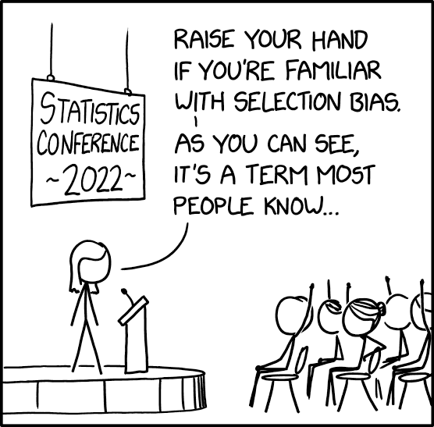
Selection Bias

Slide 59
Propensity Score Matching
A common problem we face is selection bias arising from the fact that individuals often self-select into treatment.
Those to attend job training programs may be more motivated?
This means that those who are treated may be different than those who are not treated.
Propensity Score Matching (PSM) helps construct a balanced control group by matching individuals with similar characteristics.
But why not simply match on observed characteristics?
Dimensionality will be an issue if there are many characteristics.

Slide 60
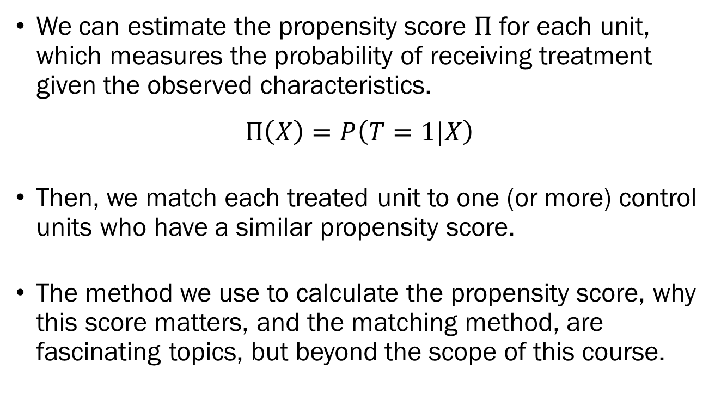
Propensity Score Matching
We can estimate the propensity score $Π$ for each unit, which measures the probability of receiving treatment given the observed characteristics.
$$Π\left(X\right)=P\left(T=1|X\right)$$
Then, we match each treated unit to one (or more) control units who have a similar propensity score.
The method we use to calculate the propensity score, why this score matters, and the matching method, are fascinating topics, but beyond the scope of this course.

Slide 61
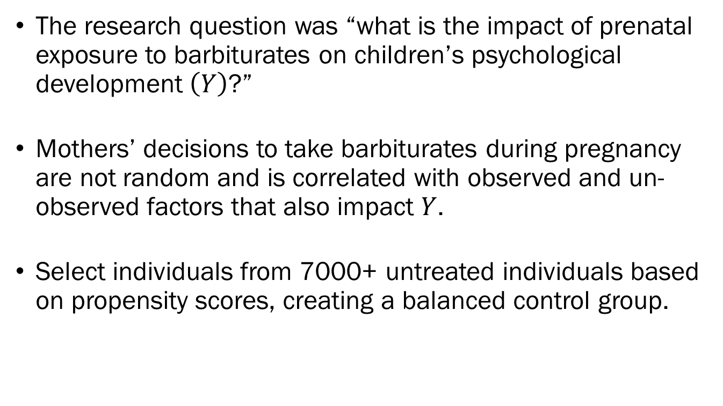
Rosenbaum & Rubin (1985) The American Statistician
The research question was “what is the impact of prenatal exposure to barbiturates on children’s psychological development $\left(Y\right)$?”
Mothers’ decisions to take barbiturates during pregnancy are not random and is correlated with observed and un-observed factors that also impact $Y$.
Select individuals from 7000+ untreated individuals based on propensity scores, creating a balanced control group.

Slide 62
Propensity Score Matching
Things to consider before applying PSM:
Propensity scores are calculated using observed variables, so if any unobserved factors are influencing both the likelihood of treatment and outcome, PSM is not valid.
The treated and untreated individuals must have a sizeable over-lap in observed variables.
The quality of the match depends on the researcher applying the correct specification to calculate propensity scores.
While there are other technical issues and considerations, those are beyond the scope of this course.

